Slide 1


“shark free holidays
consulting company”
Peaceful Holidays Consulting
Amir Abdul
Loredane Nery
Mehdi Sahraoui
To Van Cao

Slide 2
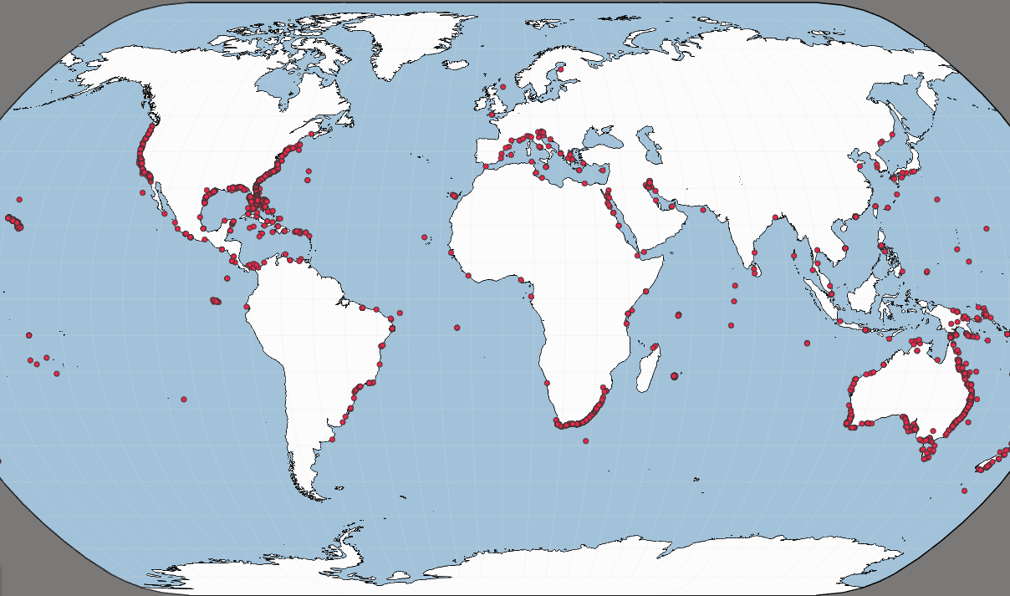
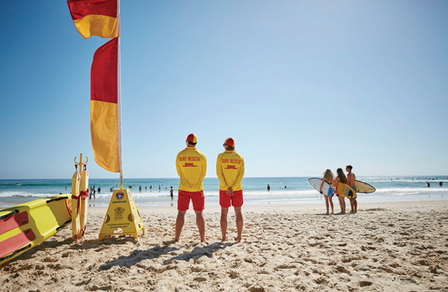
Hypothesis Business implication
Some regions in the US have more shark attacks
Where to focus security efforts ?
Notes:
We have been commissioned by an American hotel brand that owns hotels all over the country coasts.
Hypothesis is that certain coastal regions experience more shark attacks than others and we are going to identify them.
Business implication :
will be to find the states / locations where to focus security so that coastal management can implement more targeted safety protocols and warning systems in high-risk areas

Slide 3

Analysis Roadmap & Tools
Overview of the format of dates, year, age, time, gender, country…
Extra columns, rows
First hypothesis : where to implement hotels ?
Data Set global analysis
Defined business case & understanding of the dataset
Cleaning Data Set
clean N/A column and rows
clean white spaces and .capitalize in the country
General dataframe check (unique.())
Cleaning location related columns
Country
State
EDA
Analysis
Filter by year
Filter by country
Counting the attacks by country
=> focusing on a country and in a state with location
Add extra filter
Add graphics
Handling graphics format
Notes:
extra columns with no relevant information
columns that are hidden
there is a column what type information is inside with no name and values don’t make sense
date/year : different format
date / year / age (“both”, 9 or 10…)/ Time (afternoon, morning, midnight…)
not adapted type :
age that is an object and should be a integer
year is a float should be an integer

Slide 4
Analysis Roadmap & Tools
Data Set global analysis
Defined business case & understanding of the dataset
Data cleaning techniques :
str.capitalize()
.drop(columns [‘xxxxx’], inplace = True)
.dropna()
…
Pycountry library
used on the following columns :
Country
State
filter to keep only “True”
Cleaning Data Set
clean N/A column and rows
clean white spaces and .capitalize in the country
General dataframe check (unique.())
Cleaning location related columns
Country
State
EDA
Analysis
Filter by year
Filter by country
Counting the attacks by country
=> focusing on a country and in a state with location
Add extra filter
Add graphics
Handling graphics format
Notes:
extra columns with no relevant information
columns that are hidden
there is a column what type information is inside with no name and values don’t make sense
date/year : different format
date / year / age (“both”, 9 or 10…)/ Time (afternoon, morning, midnight…)
not adapted type :
age that is an object and should be a integer
year is a float should be an integer

Slide 5
Analysis Roadmap & Tools
Data Set global analysis
Defined business case & understanding of the dataset
Cleaning Data Set
clean N/A column and rows
clean white spaces and .capitalize in the country
General dataframe check (unique.())
Cleaning location related columns
Country
State
EDA
Analysis
Filter by year
Filter by country
Counting the attacks by country
=> focusing on a country and in a state with location
Add extra filter
Add graphics
Handling graphics format
Realized very first hypothesis wasn’t relevant and changed it to the final one :
focus on one country and one state
Notes:
extra columns with no relevant information
columns that are hidden
there is a column what type information is inside with no name and values don’t make sense
date/year : different format
date / year / age (“both”, 9 or 10…)/ Time (afternoon, morning, midnight…)
not adapted type :
age that is an object and should be a integer
year is a float should be an integer

Slide 6
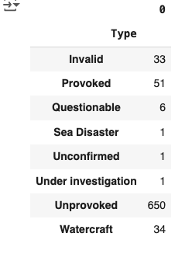
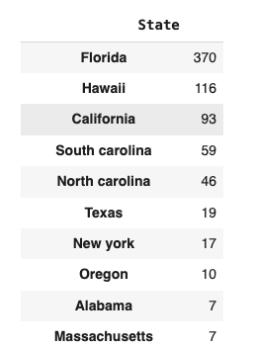
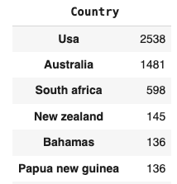
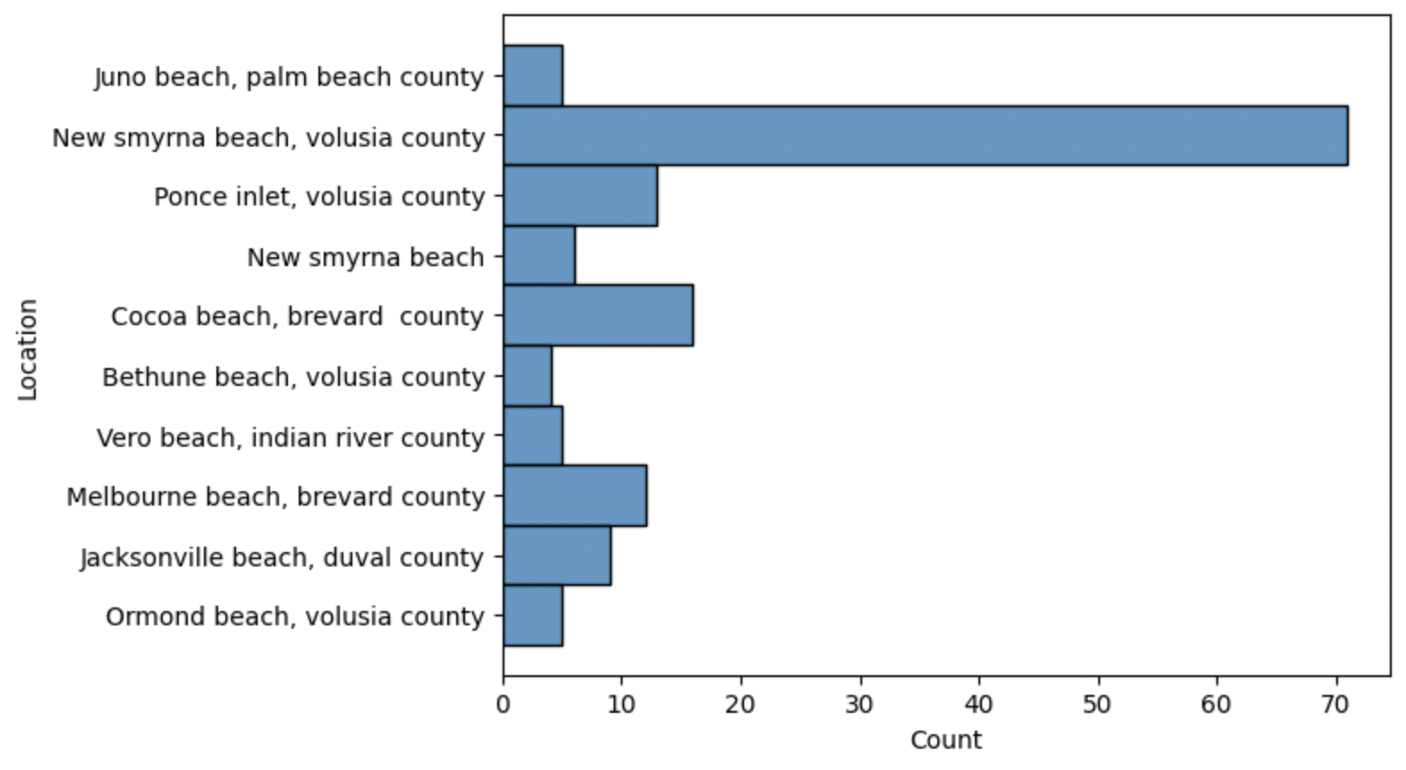
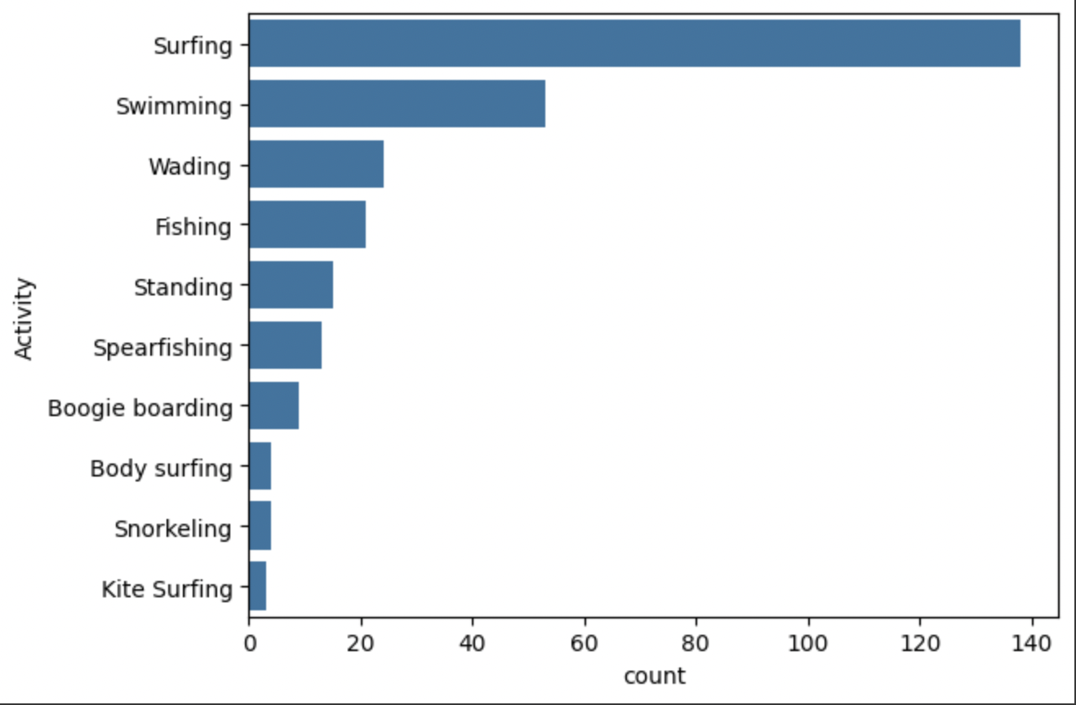
Exploratory Data Analysis
YearScope
2010 - 2024
USA
FLORIDA FOCUS
Notes:
check the countries
USA was the 1st
Florida was the 1st
we deep dive into the location

Slide 7
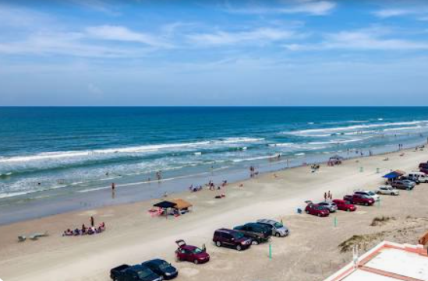

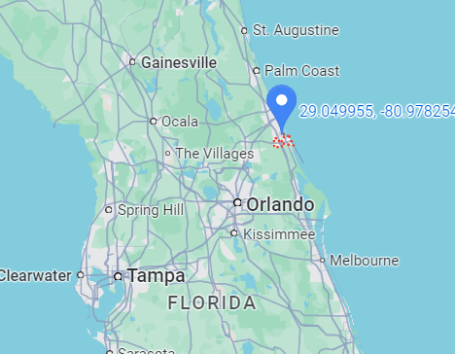

New Smyma Beach - Florida
Notes:
Conclusion and Insights (1-2 slides):
Initially, the idea was to recommend a safe location with little or no shark attacks to a hotel chain that wanted to open a new hotel. However, we found that the vast majority of attacks occurred in the United States and the original idea was not possible.
Instead of recommending a location with no shark attacks, we decided to offer advice on how to implement safety protocols in the areas with the highest incidents.
The revised focus on safety protocols not only addresses the immediate concern of shark attacks but also positions the hotel chain as a leader in guest safety and responsible tourism. This approach can turn a potential risk into an opportunity for brand differentiation and enhanced guest loyalty.
The recommendation to enhance safety protocols in high-risk areas emphasizes proactive risk management

Slide 8
Challenges
Discuss the biggest obstacle or mistake you encountered during this project :
Handling the functions
Setting the hypothesis and make decisions in the data cleaning in order to serve this hypothesis
Google collab still not flexible
Share what you learned from it and how it influenced your project :
Best practice is to clean all dataset but had to prioritize given the hypothesis and not losing sight of it
Crucial to have clear understanding of the data set in hand and scope used
Create sub category Dataframe

Slide 9
Thank you for your attention
Peaceful Holidays, Inc
Amir Abdul
Loredane Nery
To Van Cao
Mehdi Sahraoui

Slide 10
Data Wrangling and cleaning
Data Wrangling and Cleaning (1-2 slides):
Discuss the significant data cleaning challenges you encountered (missing data, duplicates, formatting issues, etc.).
Explain how you resolved these challenges.

Slide 11
Conclusion and Insights (1-2 slides):
Initially, the idea was to recommend a safe location with little or no shark attacks to a hotel chain that wanted to open a new hotel. However, we found that the vast majority of attacks occurred in the United States and the original idea was not possible.
Instead of recommending a location with no shark attacks, we decided to offer advice on how to implement safety protocols in the areas with the highest incidents.
The revised focus on safety protocols not only addresses the immediate concern of shark attacks but also positions the hotel chain as a leader in guest safety and responsible tourism. This approach can turn a potential risk into an opportunity for brand differentiation and enhanced guest loyalty.
The recommendation to enhance safety protocols in high-risk areas emphasizes proactive risk management.
Notes:
Conclusion and Insights (1-2 slides):
Initially, the idea was to recommend a safe location with little or no shark attacks to a hotel chain that wanted to open a new hotel. However, we found that the vast majority of attacks occurred in the United States and the original idea was not possible.
Instead of recommending a location with no shark attacks, we decided to offer advice on how to implement safety protocols in the areas with the highest incidents.
The revised focus on safety protocols not only addresses the immediate concern of shark attacks but also positions the hotel chain as a leader in guest safety and responsible tourism. This approach can turn a potential risk into an opportunity for brand differentiation and enhanced guest loyalty.
The recommendation to enhance safety protocols in high-risk areas emphasizes proactive risk management.

